Slide 1
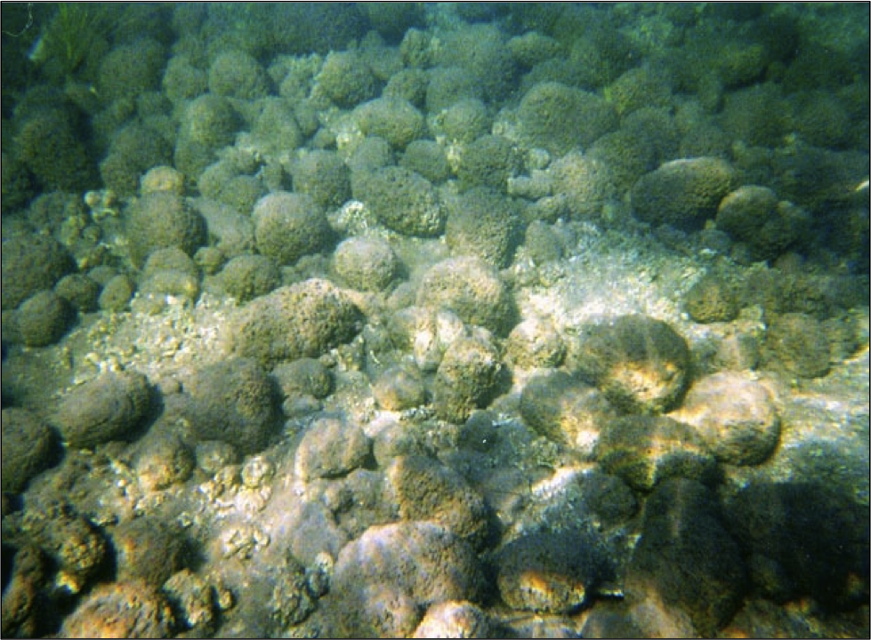


Genetic Profiling of Oncoid Stromatolites from the Phosphorus-Limited Rio Mesquites in Cuatro Cienegas, MX
Alisa Glukhova
NASA Space Grant Symposium
April 21st 2012
Mentors: Amisha Poret-Petterson
&
Ariel Anbar

Slide 2
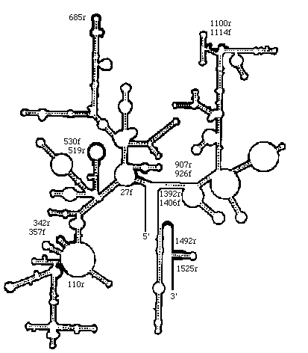
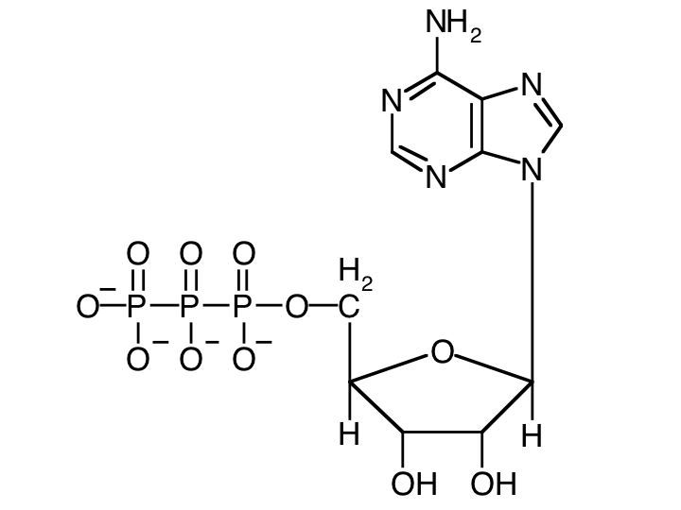

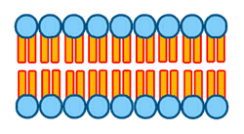
Introduction
Phosphorus (P) is an essential element for all organisms
P is an important component of biological molecules and often a limiting nutrient
DNA RNA ATP Phospholipids

Slide 3
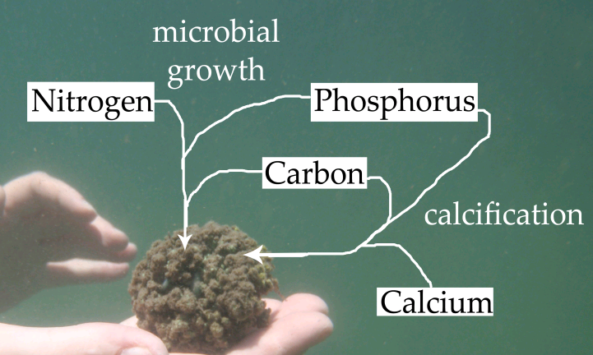
Introduction
Stromatolites are layered microbial mats
Biological growth and mineral deposition
Interaction between microbial growth, calcification, and P availability

Slide 4
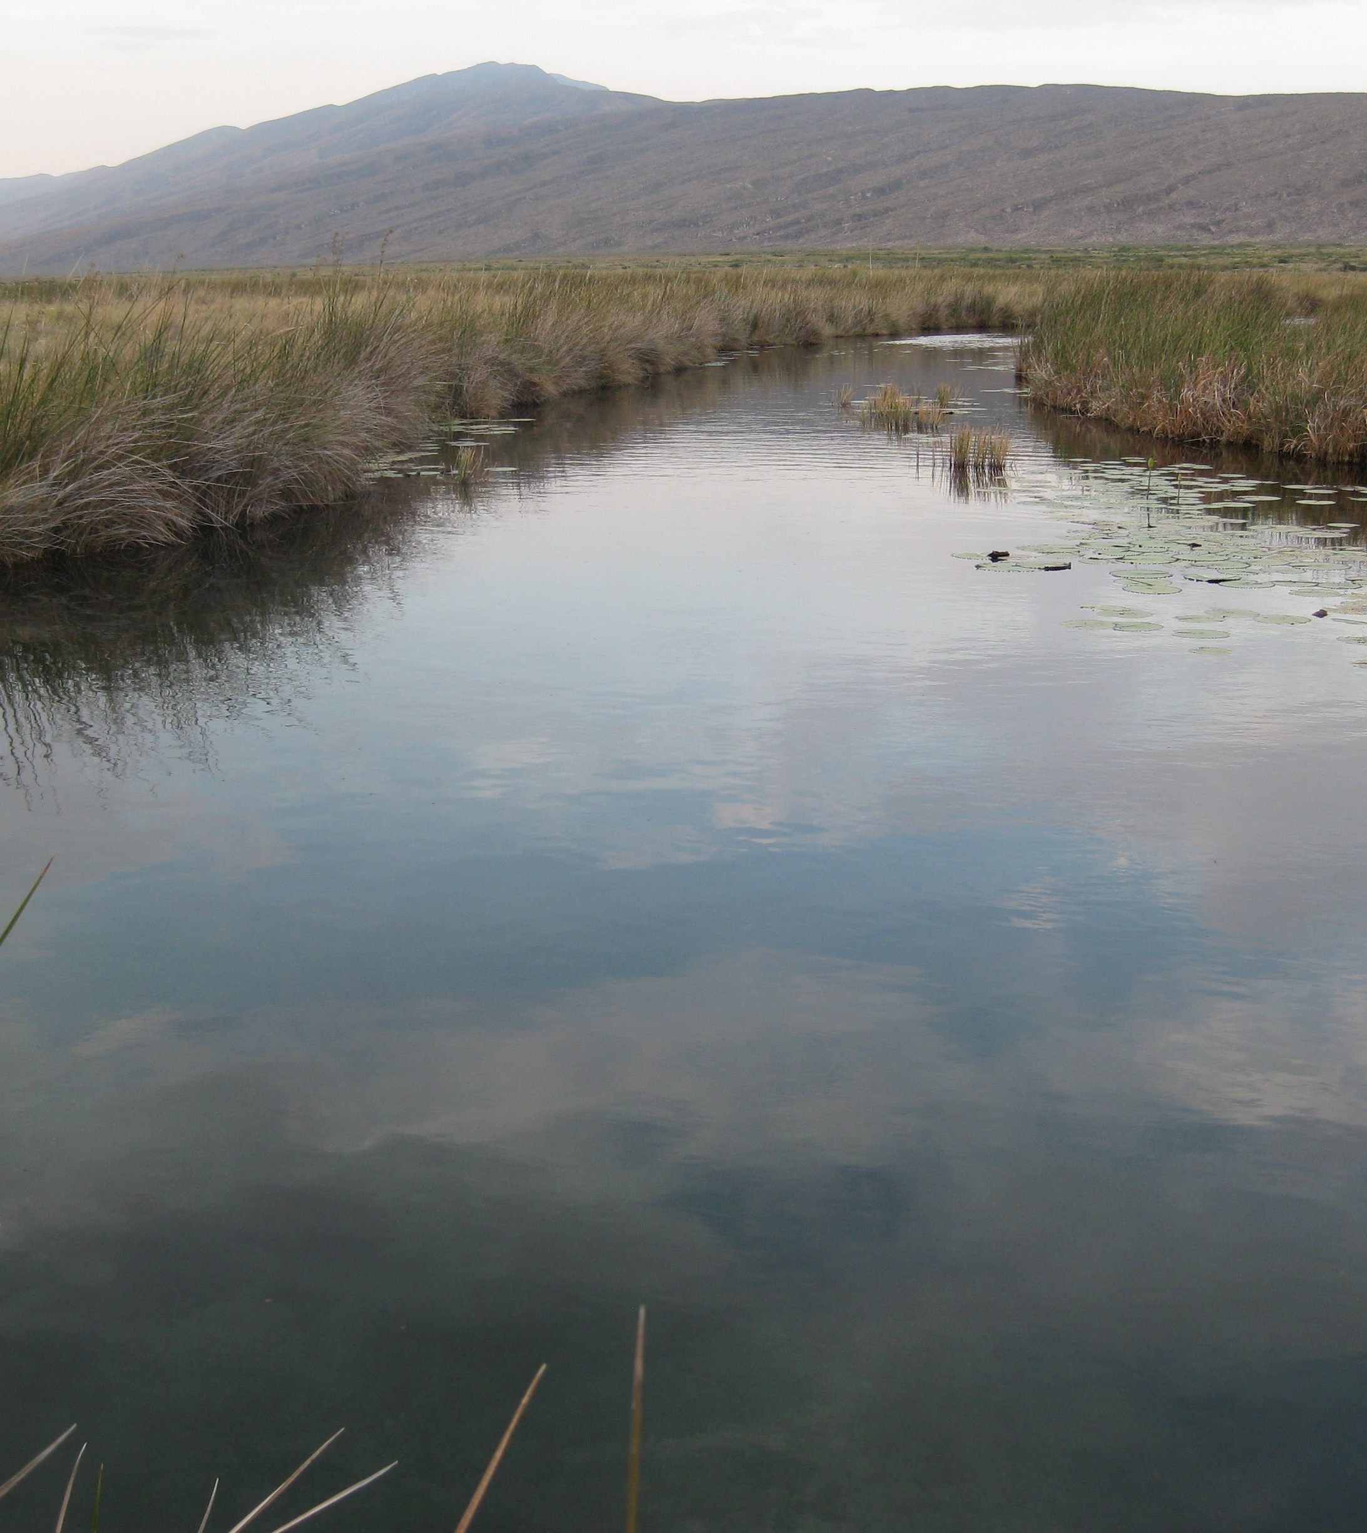
Introduction
Rio Mesquites stromatolites live in an environment with the lowest P content (0.6 μmol L⁻¹) reported in continental waters
Stromatolites thrive in Rio Mesquites because P limitation has decreased the population of snails and other grazers

Slide 5
Hypotheses
Original Community
The microbial community is P-limited and will remain the same, but increase in size due to growth (alleviation of P-limitation)
The microbes are adapted to low P conditions and a species composition change may occur with addition of P.
There could also be a combination of both.
1
2
3
Notes:
In order to test these hypothesis I generated trflps of stromatolites exposed to various concentrations of carbon of phosphorus.

Slide 6
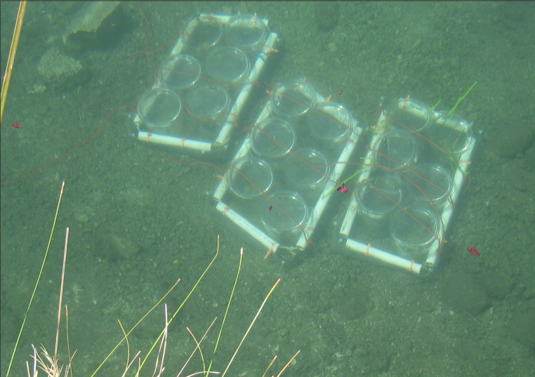
Methods
Treatments:
• Control (no addition)
• Low Phosphorus
(5 µM N₂HPO₄)
• High Phosphorus
(10 µM N₂HPO₄)
• Carbon (53 µM acetate
+ 53 µM glucose)
• Low P + Carbon
• High P + Carbon
Notes:
I used the same analysis as christie

Slide 7
Methods
T-RFLP
Microbial Community Fingerprint
PCR (8FFAM/1492R)
Restriction Digest of PCR Products
Capillary Electrophoresis
Fluorescence
T-RF
Notes:
I used the same analysis as christie
7

Slide 8
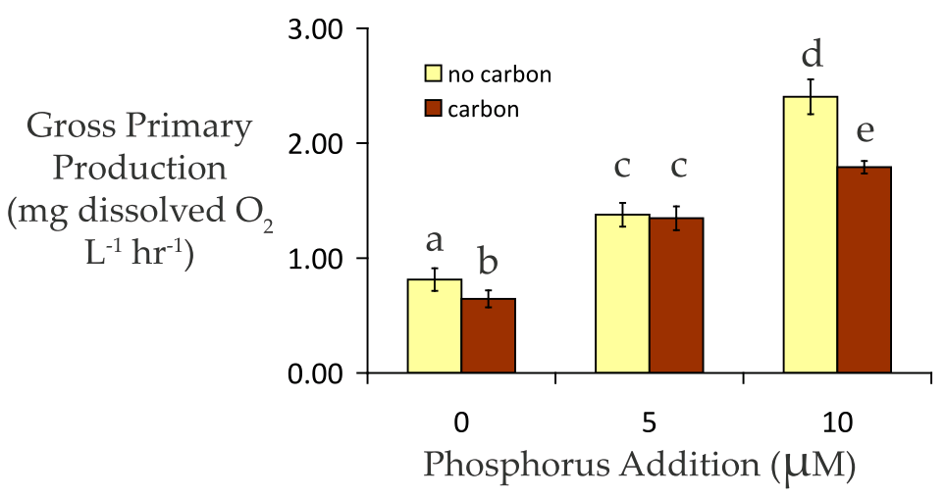
Results
Notes:
This is some data on the physiological response of the stromatolites to the experimental minipulation
Y is gross primary production measured as dissolved oxygen production
X axis is phosphorus concentrations
The yellow bars represent samples with no carbon added
The red bars represent samples with carbon added
You can see overall that primary production increases with phosphorus addition
Increases in O2 are due to photosynthesis
At the highest P addition, the increase in gross primary production is not as high. This could be due to consumption of O2 by heterotrophs performing aerobic respiration.

Slide 9
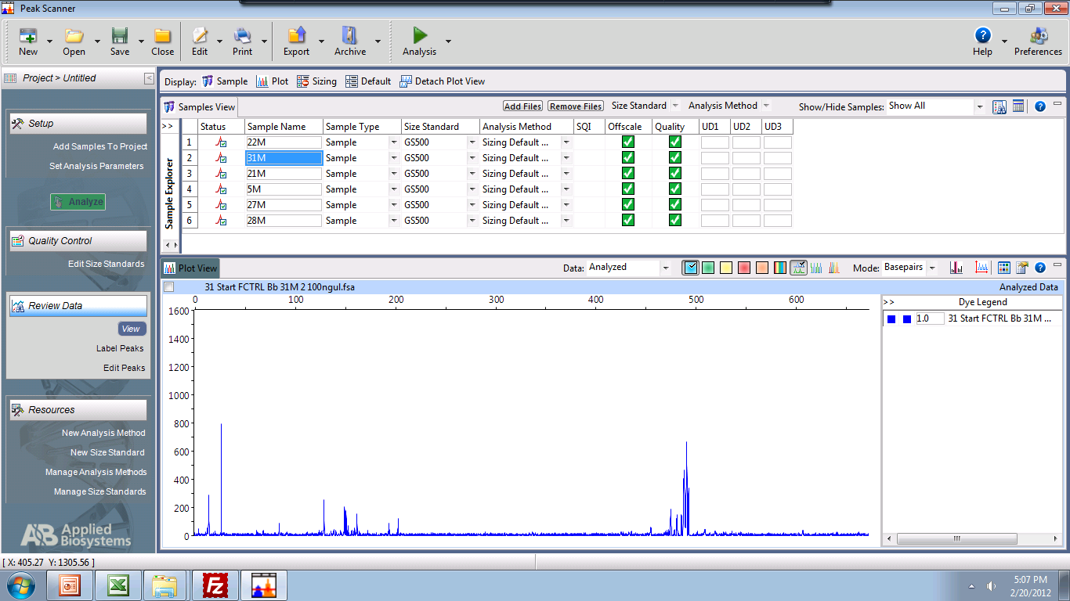
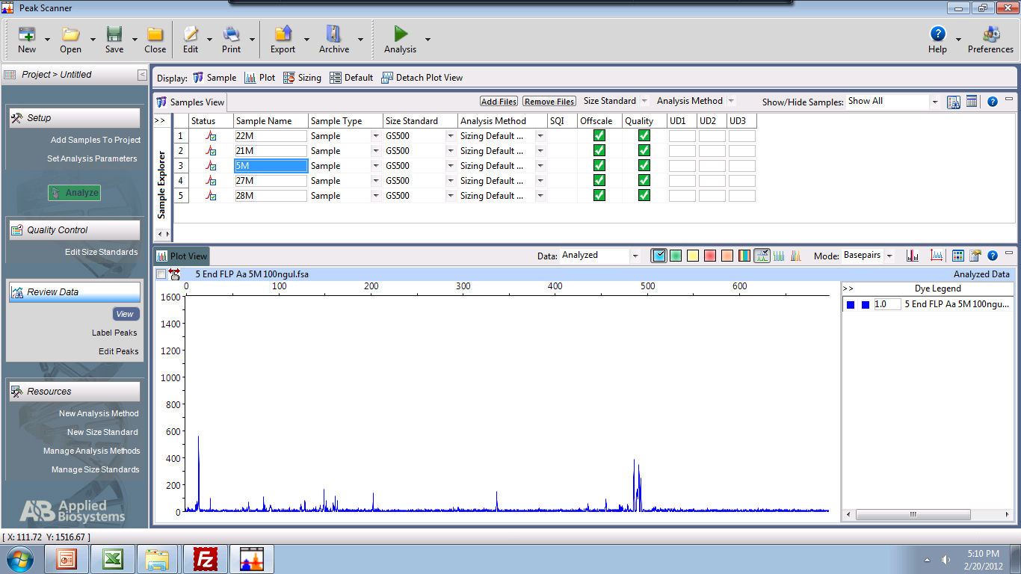
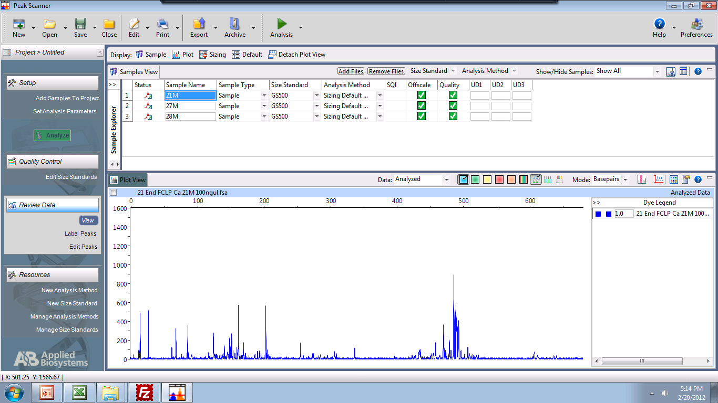
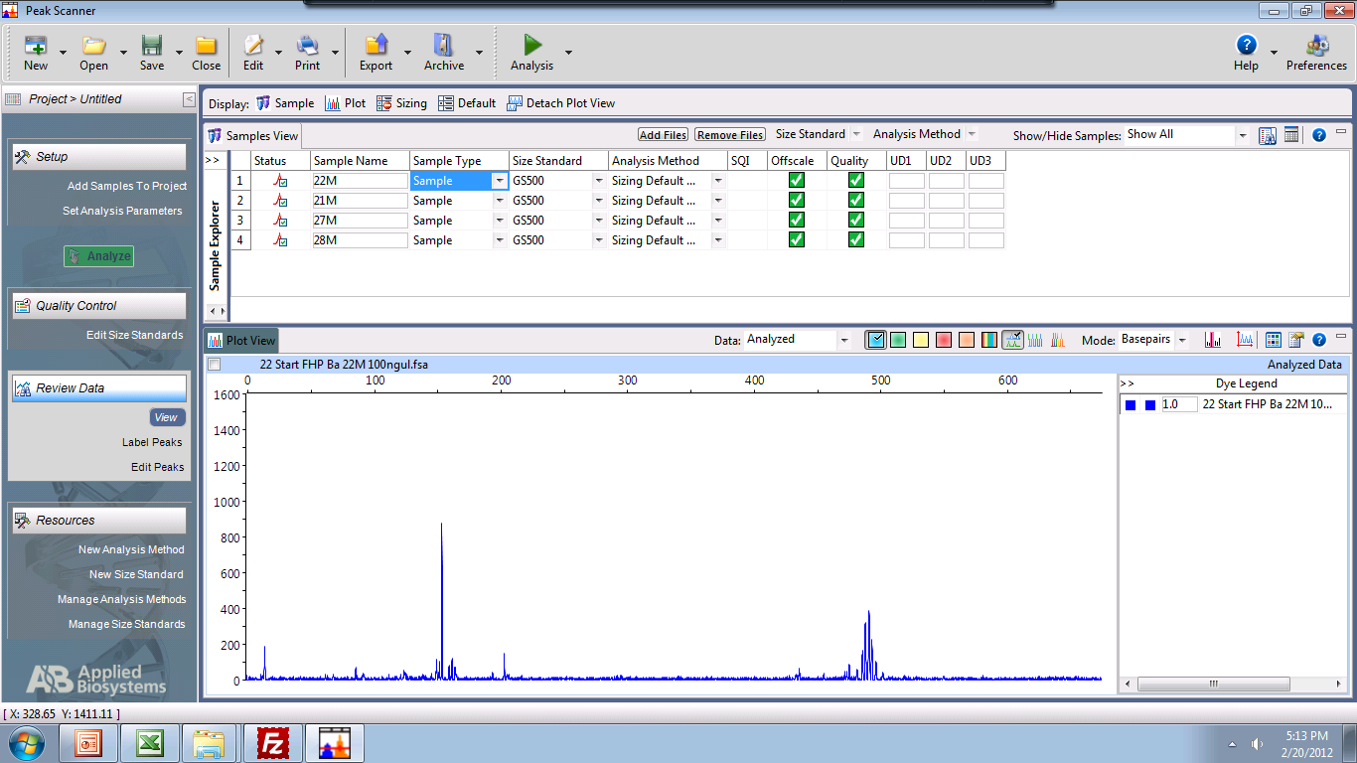
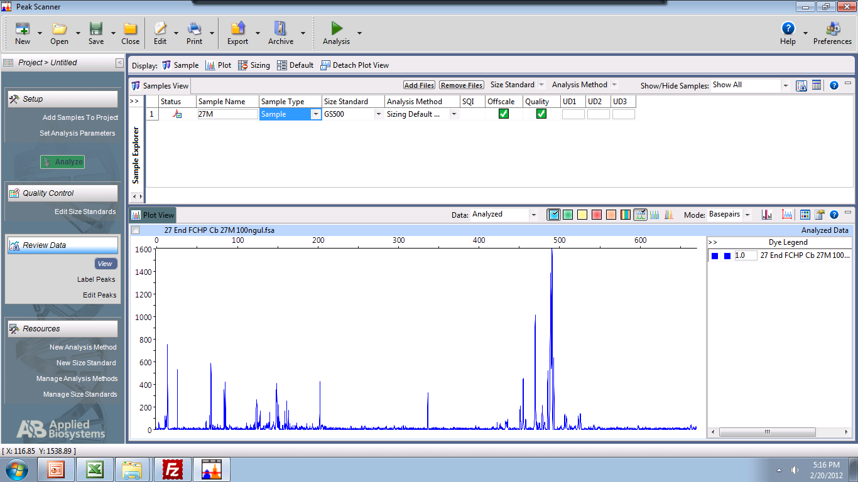
Results
Control
T-RFs become more complex with C addition
Growth ofheterotrophic bacteria
LP
CLP
HP
CHP

Slide 10
Summary & Future Directions
PCR-amplified and restricted bacterial 16S rRNA genes from oncoid stromatolites incubated with additions of C and P
Most complex T-RF patterns were obtained with organic C addition, suggesting that the population of heterotrophic microbes in stromatolites increased.
Perform a detailed analysis of these T-RF profiles to confirm these initial findings
Compare T-RFLP patterns to stromatolite chemical compostion data (C, N, and P)

Slide 11
Acknowledgements
Jessica Corman
James Elser
Ariel Anbar
Christie Sabin
Zuri Martinez

